Slide 1
JAVA COLLECTION FRAMEWORK
SPECIAL JAVA SUBJECT

Slide 2
Introduction
An application that is solving a real-world problem will generally deal with a group of data items that can be represented in Java by collections
A collection — sometimes called a container — is simply an object that groups multiple elements into a single unit.
Collections are used to store, retrieve, manipulate, and communicate aggregate data.
The collections in Java are supported by two super interfaces, Collection and Map
Java also presents some implementations of the collections interfaces that can be used as data structures to store and manipulate groups of data items, that is, objects

Slide 3
Collections
A collection is an object that organizes multiple data items into a single group
Java presents a unified architecture called the collections framework
The collections framework consists of three elements:
Interfaces: allow you to manipulate collections independently of the implementation details
Implementations: The concrete implementations of the collections interfaces
Algorithms: The methods that perform operations such as search and sorting on the objects in the data structures.

Slide 4
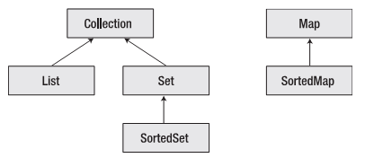
The Collections Interface
Iterable

Slide 5
The Collections Interface (cont.)
The List and Set interfaces extend from the Collection interface
There is no direct implementation of the Collection interface
List: An ordered collection of data items
A list can contain duplicate elements
ArrayList, LinkedList, and Vector are the classes that implement the List interface

Slide 6
The Collections Interface (cont.)
Set: A collection of unique items
There are no duplicates data items
HashSet and LinkedHashSet are examples of classes that implement the Set interface
Map: An object that maps keys to values:
Each key can map to at most one value
Maps cannot contain duplicate keys
HashMap and HashTable are examples of classes that implement the Map interface

Slide 7
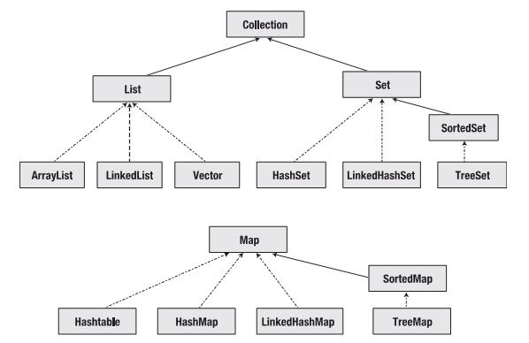
Implementations of Collections Interfaces

Slide 8
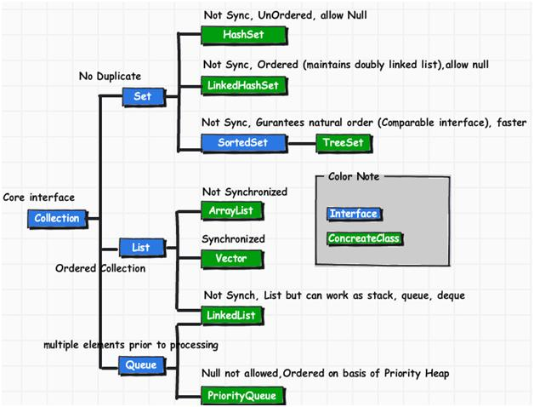
Concrete Classes: Collection
Notes:
HashSet : This class implements the Set interface, backed by a hash table (actually a HashMap instance). It makesno guarantees as to the iteration order of the set; in particular, it does not guarantee that the order will remain constant over time. This class permits the null element.
LinkedHashSet : Hash table and linked list implementation of the Set interface, with predictable iteration order. This implementation differs from HashSet in that it maintains a doubly-linked list running through all of its entries. This linked list defines the iteration ordering, which is the order in which elements were inserted into the set (insertion-order). Note that insertion order is not affected if an element is re-inserted into the set. (An element e is reinserted into a set s if s.add(e) is invoked when s.contains(e) would return true immediately prior to the invocation).
Interface SortedSet: A set that further guarantees that its iterator will traverse the set in ascending element order, sorted according to the natural ordering of its elements (see Comparable), or by a Comparator provided at sorted set creation time. Several additional operations are provided to take advantage of the ordering. (This interface is the set analogue of SortedMap).
TreeSet: This class implements the Set interface, backed by a TreeMap instance. This class guarantees that the sorted set will be in ascending element order, sorted according to the natural order of the elements (seeComparable), or by the comparator provided at set creation time, depending on which constructor is used.
ArrayList: Resizable-array implementation of the List interface. Implements all optional list operations, and permits all elements, including null. In addition to implementing the List interface, this class provides methods to manipulate the size of the array that is used internally to store the list.
Vector: This class is roughly equivalent to ArrayList except it is Synchronized.
LinkedList: Linked list implementation of the List and Queue interfaces. Implements all optional operations, and permits all elements (including null).

Slide 9
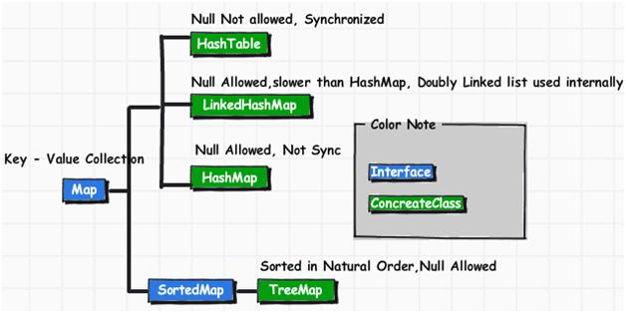
Concrete Class: MAP
Notes:
HashMap: The HashMap class is roughly equivalent toHashtable, except that it is unsynchronized and permits nulls.
HashTable: Hash table based implementation of the Map interface. This implementation provides all of the optional map operations, and permits null values and the null key. This class makes no guarantees as to the order of the map; in particular, it does not guarantee that the order will remain constant over time.
LinkedHashMap: Hash table and linked list implementation of the Map interface, with predictable iteration order. This implementation differs from HashMap in that it maintains a doubly-linked list running through all of its entries. This linked list defines the iteration ordering, which is normally the order in which keys were inserted into the map (insertion-order). Note that insertion order is not affected if a key is re-inserted into the map.
TreeMap: This class guarantees that the map will be in ascending key order, sorted according to the natural order for the key’s class (seeComparable), or by the comparator provided at creation time, depending on which constructor is used.

Slide 10
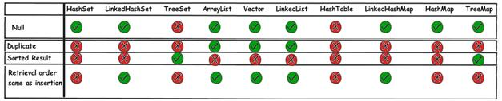
Collections Comparision

Slide 11
Iterators
iterator: An object that allows a client to traverse the elements of any collection, regardless of its implementation.
Remembers a position within a collection, and allows you to:
get the element at that position
advance to the next position
(possibly) remove or change the element at that position
Benefit: A common way to examine any collection's elements.
list
index | 0 | 1 | 2 | 3 | 4 | 5 | 6 | 7 | 8 | 9
value | 3 | 8 | 9 | 7 | 5 | 12 | 0 | 0 | 0 | 0
size | 6
"the"
set
"to"
"we"
"from"
current element: 9
current index: 2
current element: "from"
next element: "the"
iterator
iterator

Slide 12
Iterator methods
Iterator interface in java.util
every collection has an iterator() method that returns an iterator over its elements
Set<String> set = new HashSet<String>();
...
Iterator<String> itr = set.iterator();
...
hasNext() | returns true if there are more elements to examine
next() | returns the next element from the collection (throws a NoSuchElementException if there are none left to examine)
remove() | removes from the collection the last value returned by next() (throws IllegalStateException if you have not called next() yet)

Slide 13
Iterator example
Set<Integer> scores = new HashSet<Integer>();
scores.add(38);
scores.add(94);
scores.add(87);
scores.add(43);
scores.add(62);
...
Iterator<Integer> itr = scores.iterator();
while (itr.hasNext()) {
int score = itr.next();
System.out.println("The score is " + score);
// eliminate any failing grades
if (score < 60) {
itr.remove();
}
}
System.out.println(scores); // [62, 94, 87]

Slide 14
Iterator example 2
Map<String, Integer> scores = new HashMap<String, Integer>();
scores.put("Kim", 38);
scores.put("Lisa", 94);
scores.put("Ryan", 87);
scores.put("Morgan", 43);
scores.put("Marisa", 62);
...
Iterator<String> itr = scores.keySet().iterator();
while (itr.hasNext()) {
String name = itr.next();
int score = scores.get(name);
System.out.println(name + " got " + score);
// eliminate any failing students
if (score < 60) {
itr.remove(); // removes name and score
}
}
System.out.println(scores);// {Marisa=62, Lisa=94, Ryan=87}

Slide 15
Collection Interface:Traversing Collections
There are two ways to traverse collections:
(1) with the for-each construct
for (Object o : collection)
System.out.println(o);
(2) by using Iterators.
Iterator<T> iterator = collection.iterator();
while(iterator.hasNext()) {
System.out.println(iterator.next());
}

Slide 16
Collection Interface: Bulk Operations
containsAll — returns true if the target Collection contains all of the elements in the specified Collection.
addAll — adds all of the elements in the specified Collection to the target Collection.
removeAll — removes from the target Collection all of its elements that are also contained in the specified Collection.
retainAll — removes from the target Collection all its elements that are not also contained in the specified Collection. That is, it retains only those elements in the target Collection that are also contained in the specified Collection.
clear — removes all elements from the Collection.

Slide 17
Collection Interface: Array Operations
The toArray methods are provided as a bridge between collections and older APIs that expect arrays on input.
For example, suppose that c is a Collection:
Object[] a = c.toArray();
String[] a = c.toArray(new String[0]);

Slide 18
Set Interface
public interface Set<E> extends Collection<E> {
// Basic operations
int size();
boolean isEmpty();
boolean contains(Object element);
// optional
boolean add(E element);
boolean remove(Object element);
Iterator<E> iterator();
// Bulk operations
boolean containsAll(Collection<?> c);
// optional
boolean addAll(Collection<? extends E> c);
boolean removeAll(Collection<?> c);
boolean retainAll(Collection<?> c);
void clear();
// Array Operations
Object[] toArray();
<T> T[] toArray(T[] a);
}

Slide 19
Set Interface: Basic Operations
public class FindDups {
public static void main(String[] args) {
Set<String> s = new HashSet<String>();
for (String a : args)
if (!s.add(a))
...println("Duplicate detected: " + a);
...println(s.size() + " distinct words: " + s);
}
}

Slide 20
Set Interface: Bulk Operations
s1.containsAll(s2) — returns true if s2 is a subset of s1. (s2 is a subset of s1 if set s1 contains all of the elements in s2.)
s1.addAll(s2) — transforms s1 into the union of s1 and s2. (The union of two sets is the set containing all of the elements contained in either set.)
s1.retainAll(s2) — transforms s1 into the intersection of s1 and s2. (The intersection of two sets is the set containing only the elements common to both sets.)
s1.removeAll(s2) — transforms s1 into the (asymmetric) set difference of s1 and s2. (For example, the set difference of s1 minus s2 is the set containing all of the elements found in s1 but not in s2.)

Slide 21
List Interface
A List is an ordered Collection (sometimes called a sequence). Lists may contain duplicate elements. In addition to the operations inherited from Collection, the List interface includes operations for the following:
Positional access — manipulates elements based on their numerical position in the list
Search — searches for a specified object in the list and returns its numerical position
Iteration — extends Iterator semantics to take advantage of the list's sequential nature
Range-view — performs arbitrary range operations on the list.

Slide 22
List Interface
public interface List<E> extends Collection<E> {
// Positional access
E get(int index);
// optional
E set(int index, E element);
boolean add(E element);
void add(int index, E element);
E remove(int index);
boolean addAll(int index, Collection<? extends E> c);
// Search
int indexOf(Object o);
int lastIndexOf(Object o);
// Iteration
ListIterator<E> listIterator();
ListIterator<E> listIterator(int index);
// Range-view
List<E> subList(int from, int to);
}

Slide 23
List Interface: Interators
public interface ListIterator<E> extends Iterator<E> {
boolean hasNext();
E next();
boolean hasPrevious();
E previous();
int nextIndex();
int previousIndex();
void remove(); //optional
void set(E e); //optional
void add(E e); //optional
}

Slide 24
Map Interface
public interface Map<K,V> {
// Basic operations
V put(K key, V value);
V get(Object key);
V remove(Object key);
boolean containsKey(Object key);
boolean containsValue(Object value);
int size();
boolean isEmpty();
// Bulk operations
void putAll(Map<? extends K, ? extends V> m);
void clear();
// Collection Views
public Set<K> keySet();
public Collection<V> values();
public Set<Map.Entry<K,V>> entrySet();
// Interface for entrySet elements
public interface Entry {
K getKey();
V getValue();
V setValue(V value);
}}

Slide 25
Features of the Implementation
Performance: the time taken by a specific operation on the data such as searching, sorting
Ordered/sorted: the data items are in some order
Uniqueness of items: each data item in the structure must be uniquely identifiable, or on the contrary
Synchronized: the implementation offer support for thread safety

Slide 26
Implementing the List Interface
ArrayList
Can grow in number of elements
Provide constant-time access to a specific element in the list
LinkedList
Insertions and Deletions are constant in time
Random access in LinkedListis linear in time
Vector
Much like ArrayList but it provides support for synchronization for thread safety
If you are not programming for a multithreaded environment (that is, you don’t need thread safety), use ArrayList instead of Vector

Slide 27
Implementing the Set Interface
HashSet
Provide the faster access to a data item as compared to TreeSet
No guarantee that the items will be ordered
TreeSet
This presents sorted data items, but the access performance is not as good as HashSet
LinkedHashSet
Like a HashSet that maintains a doubly linked list that runs through all the data items
It is an ordered collection, ordered by insertion, but not sorted
All of those does not offer synchronization

Slide 28
Implementing the Map Interface
HashTable
Base on the hashtable data structure
Can use any non-null object as a key or a value
The objects used as keys must implement the hashCode() method and the equals(…) method in order to successfully store and retrieve objects
HashMap
Base on the hashtable data structure
Like the HashTable implementation, but it allows null and is unsynchronized
Hashmap is much faster and uses less memory than Hashtable

Slide 29
Implementing the Map Interface
LinkedHashMap
Define the iteration order, which is usually the order in which the keys are inserted into the map
TreeMap
Implement the SortedMap interface
Guarantees that the map will be in the ascending key order (that is, sorted)
This implementation is unsynchronized

Slide 30
Performing a Search on Collections
You can search for a specified element in a collection or array by using the binarySearch() method
Return the integer index of the searched element if the search is successful
You must sort the collection (or array) before conducting a search on it

Slide 31
import java.util.*;
class SearchCollectionTest {
public static void main(String[] args) {
String [] str = {"Mark", "Ready", "Set", "Go"};
System.out.println("Unsorted:");
for (String s : str) System.out.print(s + " ");
System.out.println("\nGo = " + Arrays.binarySearch(str, "Go"));
Arrays.sort(str);
System.out.println("Sorted in natural order:");
for (String s : str) System.out.print(s + " ");
System.out.println("\nGo = " + Arrays.binarySearch(str, "Go"));
System.out.println("Sorted in reverse order using a Comparator:");
MyReverseSorter ms = new MyReverseSorter();
Arrays.sort(str, ms);
for (String s : str) System.out.print(s + " ");
System.out.println("\nGo = " + Arrays.binarySearch(str, "Go"));
System.out.println("Go = " + Arrays.binarySearch(str, "Go", ms));
}
}
class MyReverseSorter implements Comparator<String> {
public int compare(String s1, String s2) {
return s2.compareTo(s1);
}
}

Slide 32
Generics - Introduction
When you take an element out of a Collection, you must cast it to the type of element that is stored in the collection
This is unsafe. The compiler does not check that your cast is the same as the collection's type, so the cast can fail at run time
Generics provides a way for you to communicate the type of a collection to the compiler
So that it can be checked
The compiler can check that you have used the collection consistently and can insert the correct casts on values being taken out of the collection

Slide 33
Object Class
The Java language offers a class called Object from which all the other classes are explicitly or implicitly derived
The Object class is the root of the class hierarchy tree
Every class that you write automatically inherit the methods of the Object class even if you don’t extend Object explicitly in your class declaration
Object Class’ Constructor:
public Object()

Slide 34
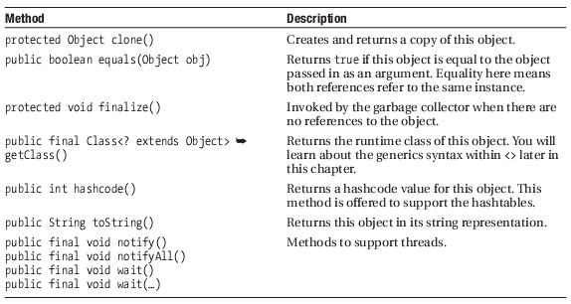
Object Class Methods

Slide 35
The equals() Method
The default implementation of the equals(…) method in the Object class is just uses the == operator for comparison
you can override this method in the class that you write and give it a deeper meaning
The equals() Contract:
It is reflexive. For any reference value x, x.equals(x) should return true.
It is symmetric. For any reference values x and y, x.equals(y) should return true if and only if y.equals(x) returns true.
It is transitive. For any reference values x, y, and z, if x.equals(y) returns true and y.equals(z) returns true, then x.equals(z) must return true.
It is consistent. For any reference values x and y, multiple invocations of x.equals(y) consistently return true or consistently return false, provided no information used in equals comparisons on the object is modified.
For any non-null reference value x, x.equals(null) should return false.

Slide 36
class ObjectOne {
private int x = 0;
private int y = 0;
ObjectOne(int x, int y) {
this.x = x;
this.y = y;
}
public int getX() {
return x;
}
public int getY() {
. return y;
}
}

Slide 37
class ObjectTwo {
private int x = 1;
private int y = 2;
public boolean equals(Object object) {
ObjectOne obj = (ObjectOne) object;
if ((obj.getX() == x) && (obj.getY() == y)) {
return true;
} else {
return false;
}
}
}

Slide 38
public class ObjectTest {
public static void main(String[] args) {
ObjectOne obj1a = new ObjectOne(1,2);
ObjectOne obj1b = new ObjectOne(1,2);
ObjectTwo obj2 = new ObjectTwo();
if (obj1a.equals(obj1b)) {
System.out.println("obj1a is equal to obj1b");
}else {
System.out.println("obj1a is not equal to obj1b");
}
if(obj2.equals(obj1a)){
System.out.println("obj1a is equal to obj2");
}else {
. System.out.println("obj1a is not equal to obj2");
}
}
}

Slide 39
The toString() Method
This method invoked on an object returns a string representation of the object
The default implementation returns the object’s class name, followed by the at sign (@) character, followed by the hashcode of the object in hexadecimal representation
OurClass@18d107f

Slide 40
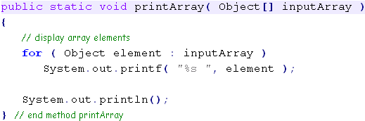
Introduction to Generics
Question: Write method for print an array of integer, double, string and so on

Slide 41
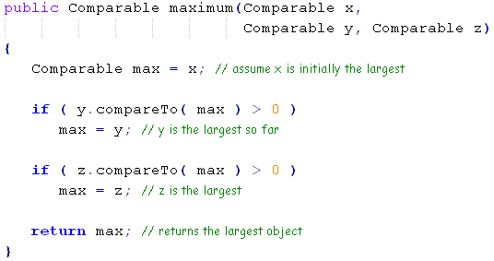
Introduction to Generics (cont.)
Question: Write an method find the maximum value of three input (integer, double, string and so on)

Slide 42
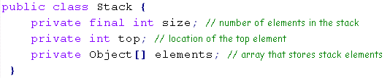
Introduction to Generics (cont.)
Question: Write an stack can be operated on all types (integer, double, string …)
Solution:

Slide 43
What is Generics ?
Allow you to specify element type of collection
Enforce specification at compile time
“Stronger typing with less typing”
Go way beyond collections

Slide 44
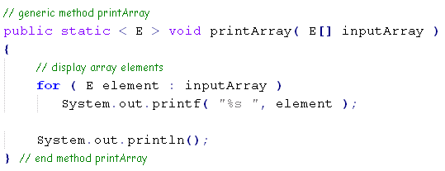
How To Program

Slide 45
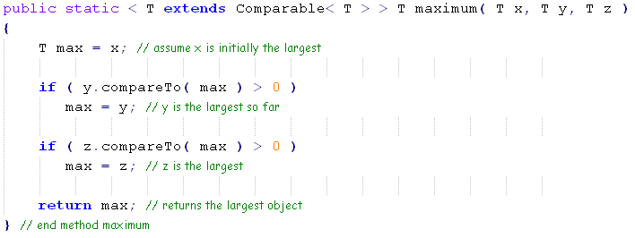
How To Program (cont.)

Slide 46
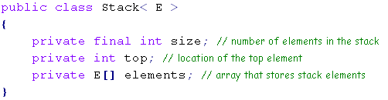
How To Program (cont.)
Stack< Double > doubleStack;

Slide 47
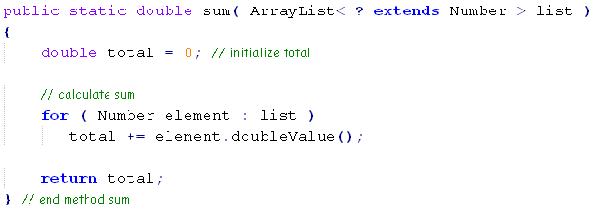
Wild card

Slide 48

Note

Slide 49
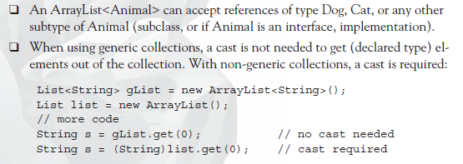
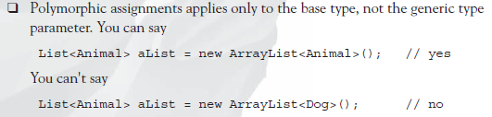
Generic Summary

Slide 50
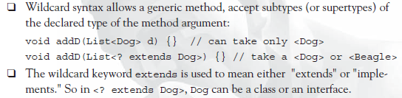
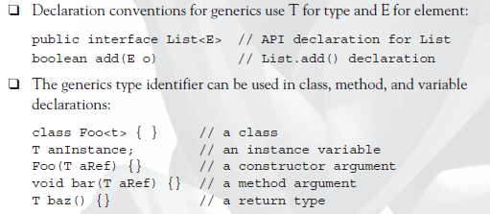
Generic Summary

